Slide 1
Connected Device Studio Device SDK
Walker Lin
Microsoft IoT Innovation Center

Slide 2
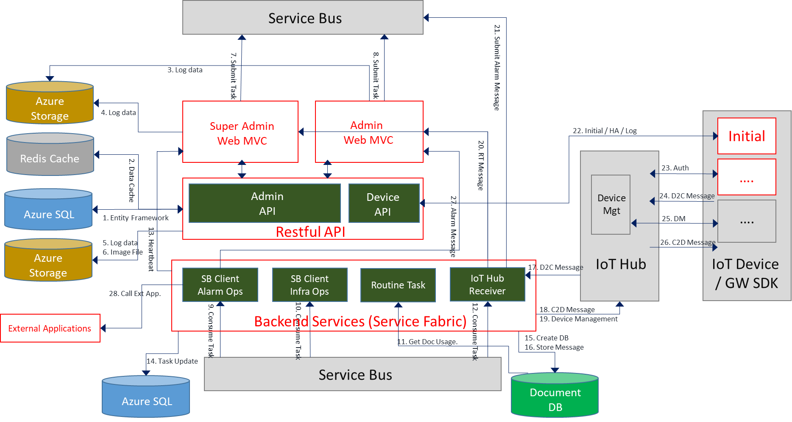
Architecture

Slide 3
Device SDK
Goal
Integration with Azure IoT Device SDKs for easily use Connected Device Studio on the IoT Devices.
Features
Fully management with back-end and Azure services
Adjustable device settings as IoT Hub alias, protocols, and Authentication type
Message validation by the predefined schema
Send telemetry data with retry mechanism
Cloud-to-Device message and ack supported
Failover on IoT Hub
File upload (via IoT Hub)
Ready for C# and Node.js SDKs

Slide 4

Diagram
Setup the Device Configurations from portal
Device SDK
Call APIs to get the Device Configurations
Azure
API Service
SQL DB
Admin
Web
Device Configurations
Send/Receive the messages
File Upload
IoT Device
1
Application
IoT Hub Alias
Back-end Services
(IoT Hub Receiver)
IoT Hub (Primary)
IoT Hub (Secondary)
C#/Node.js Device SDK
2
3
BLOB
Cosmos DB

Slide 5
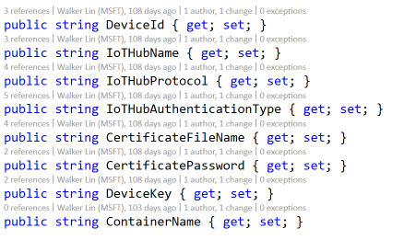
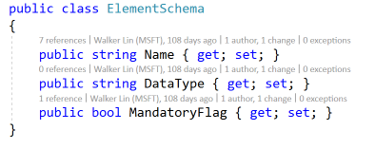
1. Call APIs to get Device Configurations
Create the SfDeviceClient from app settings
Device ID & PW
X.509 Certificate (Optional)
IoT Device
Azure
Application
API Services
Create the SfDeviceClient
1. Get Token by ID and PW
Initial method
initial()
Get Token if it was expired or invalid.
C#/Node.js
Device SDK
Get the device model
2. Get the device model
Get the message schema list
3. Get the message schema list

Slide 6
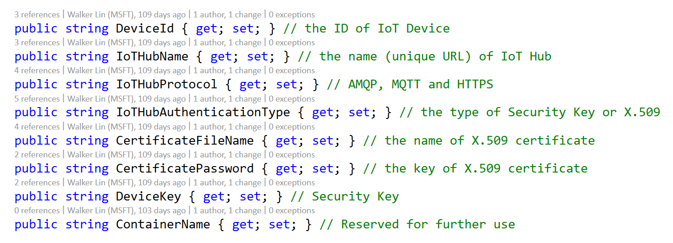
Device Model
Security Key
Connection String of IoT Hub = IoTHubName + DeviceId + DeviceKey
X.509
Connection String of IoT Hub = IoTHubName + DeviceId + x509=true
And
use the x.509 authentication method of Azure IoT Device SDKs to connect the device to IoT Hub

Slide 7
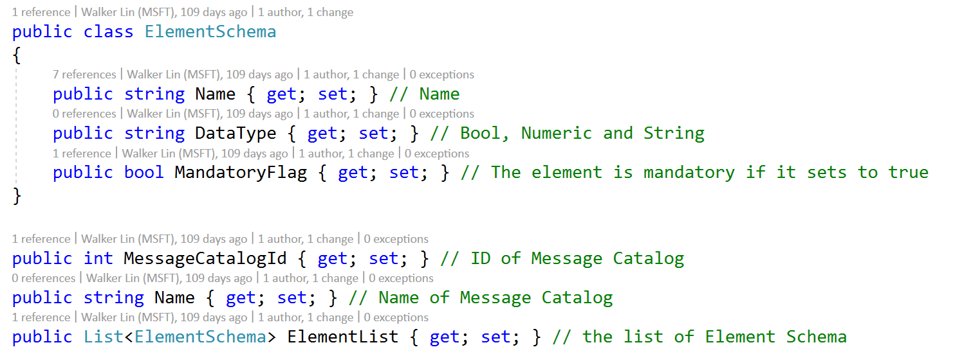
Message Schema
Use the list of Message Schema of this device to validate the telemetry messages before the sending

Slide 8
2. Send the telemetry messages
IoT Device
Azure
SendEventAsyncWithRetry method
Message Catalog ID
Payload
Application
IoT Hub Alias
Send Event
Message Validation
Drop the single element if it doesn’t exist in the schema list.
Re-pack the telemetry with message property (Message Catalog ID)
IoT Hub (Primary)
SendEventAsyncWithRetry()
C#/Node.js
Device SDK
Message Validation
Send to IoT Hub
Use SendEventAsync method of Azure IoT Device SDK
Failover with the working IoT Hub
Retry count with exponential back-off
IoT Hub (Secondary)
Send To IoT Hub

Slide 9
Failover on IoT Hub
Start
Get the working IoT Hub again via the re-initial process
Exponential back-off
Initial
Send Event
Re-initial
No
Reach Maximum Retry Count?
Success
IoTHubException
Yes
Done
Exception with maximum retry

Slide 10
2. Receive the Cloud-to-Device messages
Listen the C2D messages from IoT Hub
Use ReceiveAsync method of Azure IoT Device SDK
IoT Device
Azure
Application
Back-end
Services
Notify the application by ReceiveAsync method
Receive Event
C2D Message
The application must set the state to completed by CompleteAsync method
Update the message state in IoT Hub
CompleteAsync()
ReceiveAsync()
IoT Hub Alias
C#/Node.js
Device SDK
IoT Hub (Primary)
Azure IoT Device SDK
Next phase for
Reject
Abandon
https://docs.microsoft.com/en-us/azure/iot-hub/iot-hub-devguide-messages-c2d
Completed
IoT Hub (Secondary)

Slide 11
3. File Upload
Config the File Upload endpoint of IoT Hub in the Azure Portal
Provide the Storage Account of Blob
Choose the Container
IoT Device
Azure
Application
File Upload
Call the UploadFileToBlob method with
Full file path and name
Blob Name
UploadFileToBlob()
C#/Node.js
Device SDK
IoT Hub Alias
IoT Hub (Primary)
BLOB
(Primary)
Upload to Blob via IoT Hub
Use the UploadToBlobAsync method of Azure IoT Device SDK
Upload to the specified BLOB by the working IoT Hub
Azure IoT Device SDK
IoT Hub (Secondary)
BLOB
(Secondary)

Slide 12
File Structure
Blob
Container
Device ID 1
Device ID 2
Device ID 3
…
001.png
002.png
101.mov
…
Storage Account
IoT Device ID
Blob File
Attachment Container

Slide 13
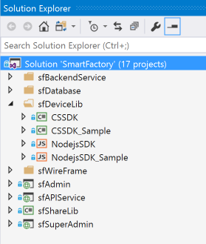
Project Structure
Name: sfDeviceLib
4 Projects
CSSDK: Device SDK for C#
CSSDK_Sample: The sample app for C# SDK
NodejsSDK: Device SDK for Node.js
NodejsSDK_Sample: The sample app for Node.js SDK

Slide 14
What the next will be done
Device Management
Regularly updated for new Azure IoT Device SDKs
X.509 on Node.js SDK
Bug fixes

